Slide 1
Project 2: Implementation of Dijkstra and A* algorithm on point and rigid robots
Due Date – 03/31/2019

Slide 2
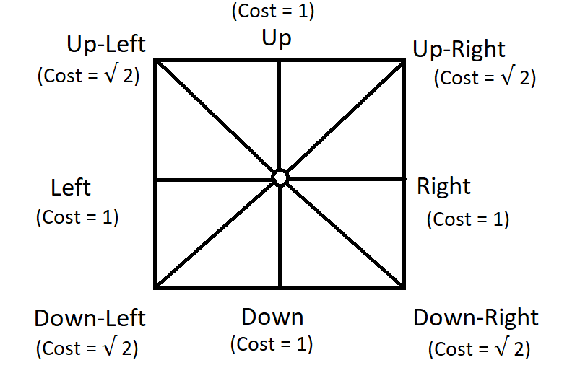
Dijkstra and A* on a point robot
Implement Dijkstra and A* algorithm to find a path between start and end point on a given map for a point robot (radius = 0; clearance = 0).
Consider workspace as a 8 connected space, that means now you can move the robot in up, down, left, right & diagonally between up-left, up-right, down-left and down-right directions.

Slide 3
Dijkstra and A* on a point robot (Continued..)
Use Half planes and semi-algebraic models to represent the obstacle space. (Read Chapter 3: Geometric Representations and Transformations from Planning Algorithms by Steven M. LaValle)
Show optimal path generation animation between start and goal point using a simple graphical interface. You need to show both the node exploration as well as the optimal path generated.

Slide 4
Dijkstra and A* on a point robot (Continued..)
For this part of the project your code must take following inputs from the user
Start point
Resolution / Grid Size for the map
Goal point
Remember to check the feasibility of all inputs
Your code must output an animation of optimal path generation between start and goal point on the map. You need to show both the node exploration as well as the optimal path generated. ( For Python and C++, students can use openCV to make the GUI)

Slide 5
Dijkstra and A* on a rigid robot
Implement Dijkstra and A* algorithm to find a path between start and end point on a given map for a rigid robot (radius ≠ 0, clearance ≠ 0).
Consider workspace as a 8 connected space.
Use Half planes and semi-algebraic models to represent the obstacle space.
Use Minkowski addition to enlarge the obstacles.
Show optimal path generation animation between start and goal point using a simple graphical interface.

Slide 6
Dijkstra and A* on a rigid robot (Continued..)
For this part of the project your code must take following inputs from the user
Start point
Robot radius
Clearance
Resolution / Grid Size for the map
Goal point
Remember to check the feasibility of all inputs
Your code must output an animation of optimal path generation between start and goal point on the map. You need to show both the node exploration as well as the optimal path generated. ( For Python and C++, students can use openCV to make the GUI)

Slide 7
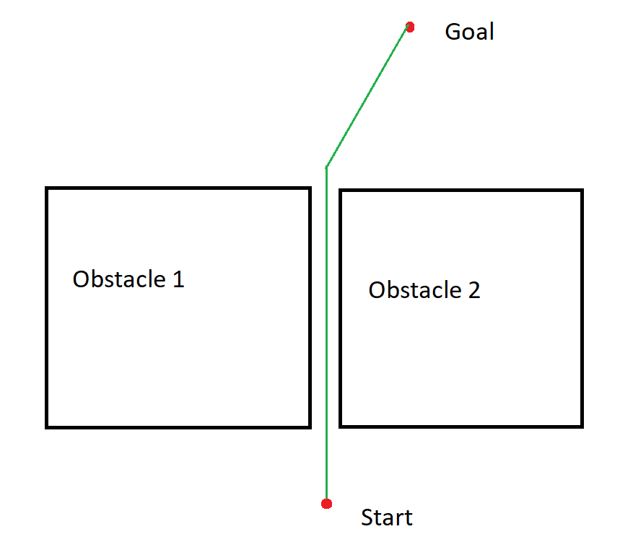
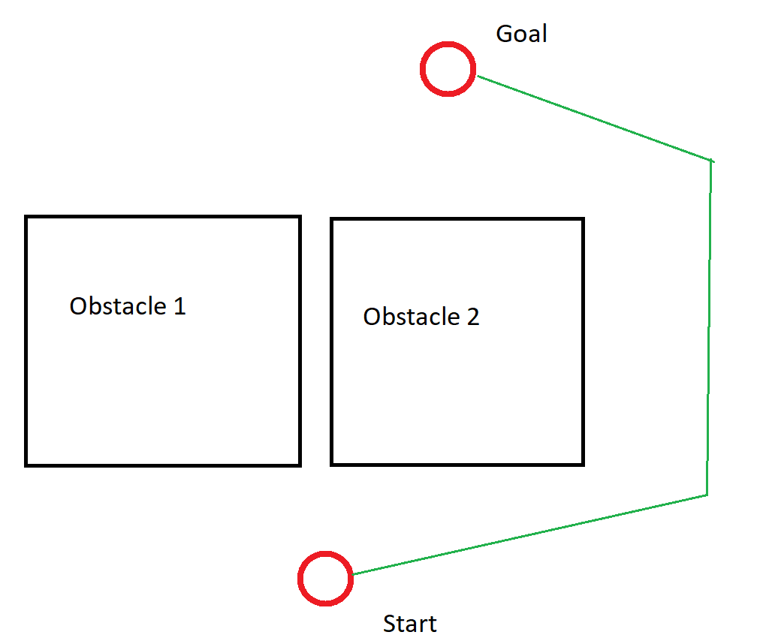
Difference between point and rigid robot
Navigation scenario for point robot
Navigation scenario for rigid robot

Slide 8
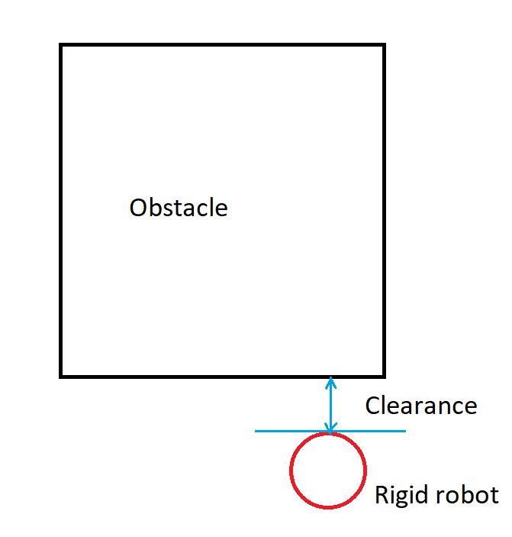
Clearance
Clearance is a maximum distance between the obstacle and the extreme point of the rigid robot.

Slide 9
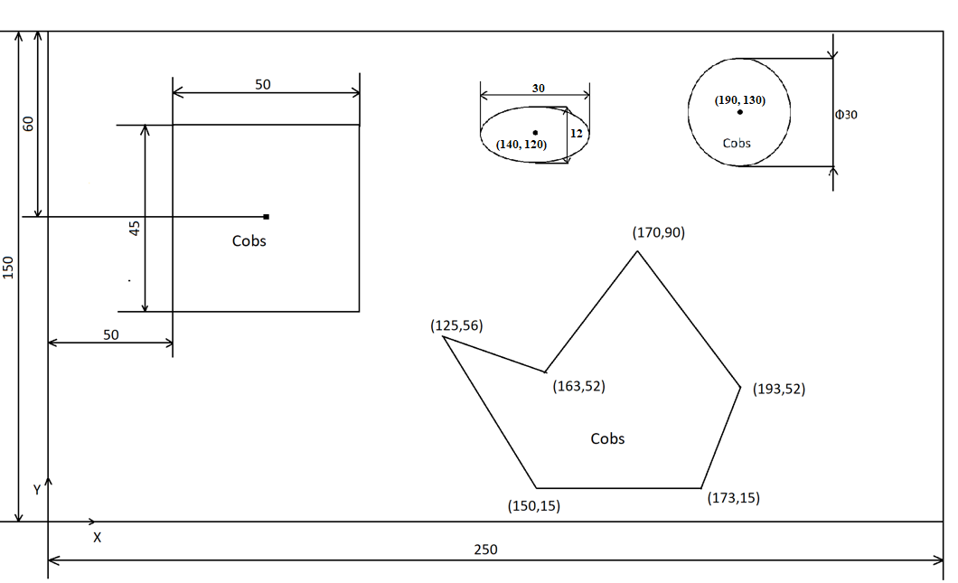
Map to be Used
Note –
1) The map is not scaled to the true dimensions

Slide 10
Due Date and Deliverables
Due date: 03/31/2019
Deliverables:
ReadMe file (Describing how to run the code)
Source files for
Dijkstra_point
Dijkstra_rigid
A*_point
A*_rigid

Slide 11
Submission Details
You are required to submit a zip file with the file structure as shown
proj2_firstname_lastname_codingLanguage
codes
readme.txt

